Slide 1
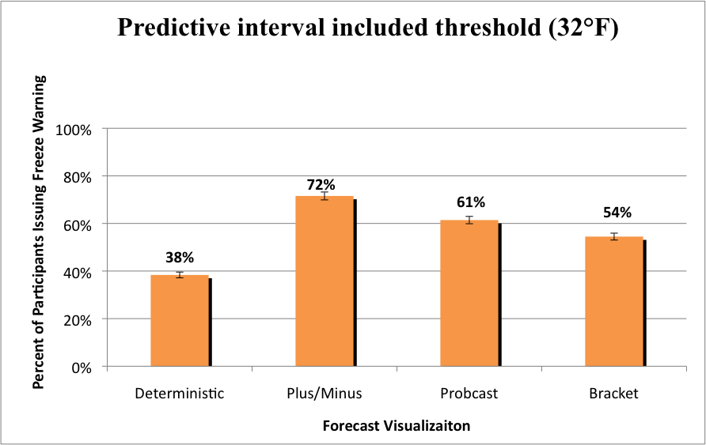
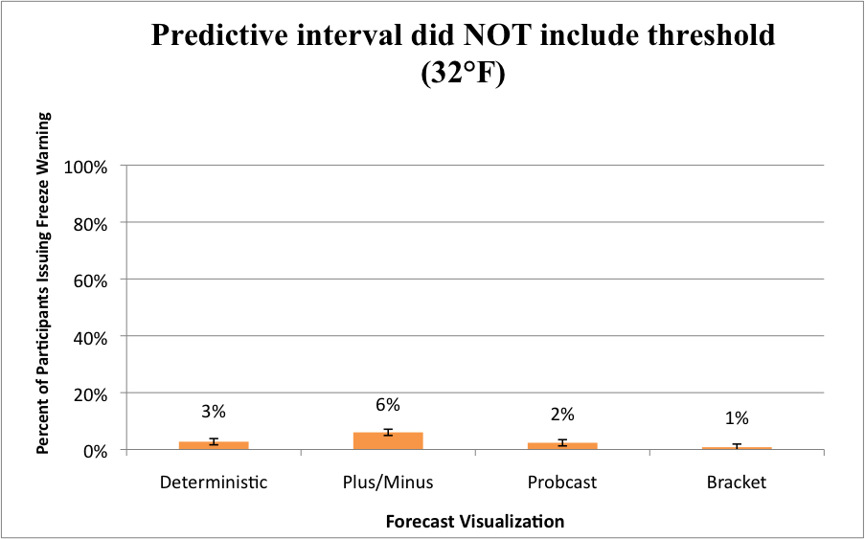
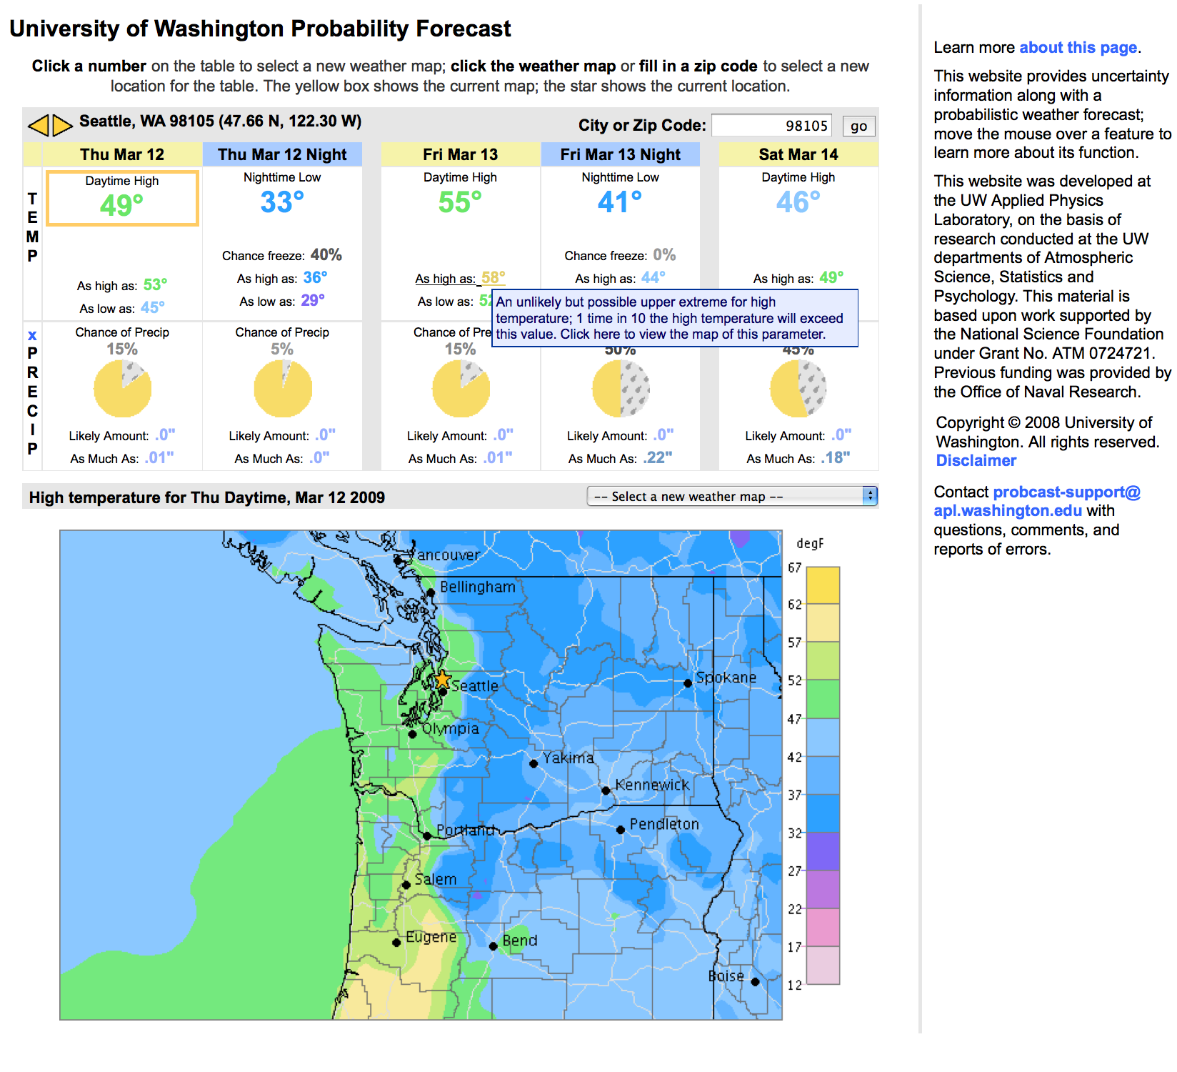
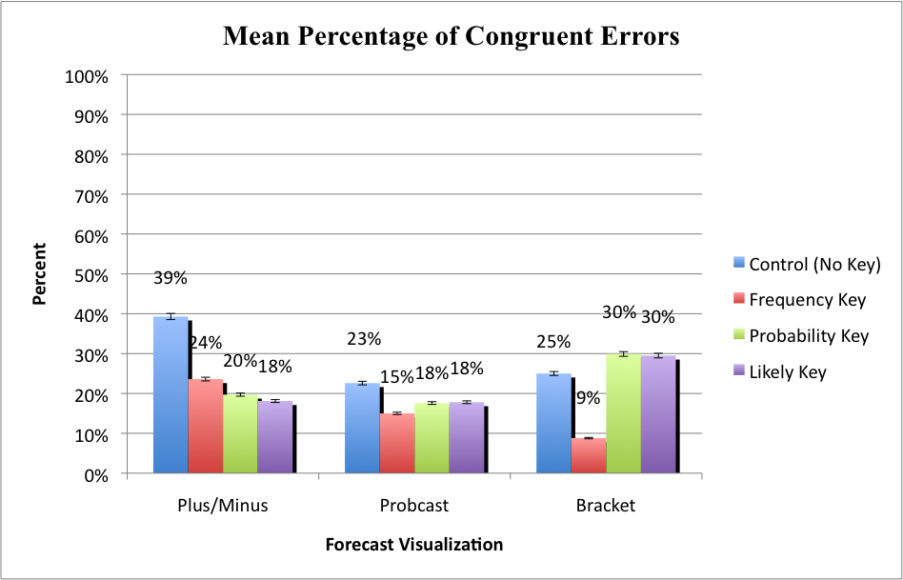
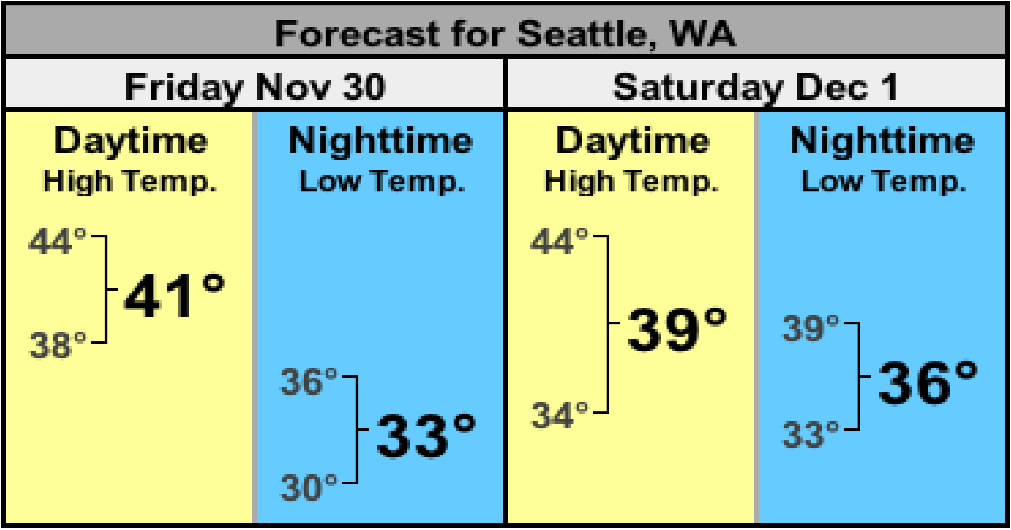
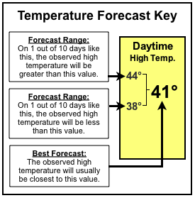
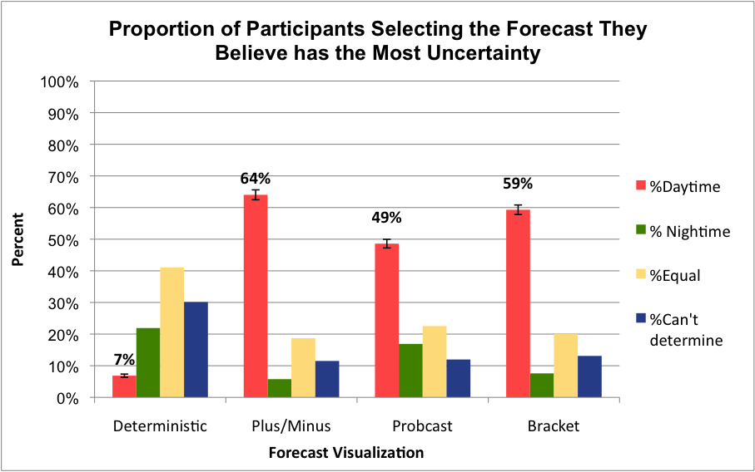
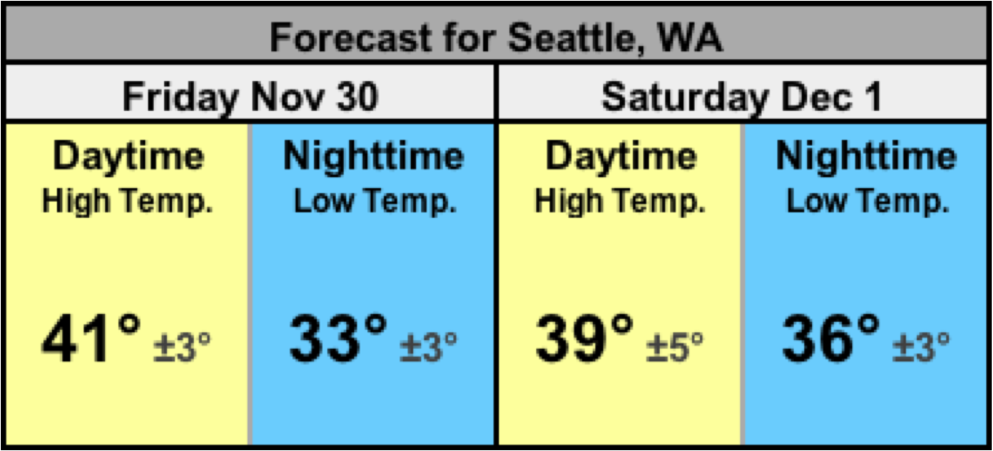
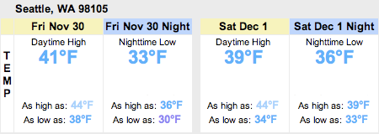
Visualizing Forecast Uncertainty
For a Non-expert Web Audience
Sonia Savelli & Susan Joslyn
University of Washington
Seattle, Washington, USA
Probcast Website
Results
Probcast.com: Weather forecast website for non-expert end-users showing uncertainty: the upper and lower bounds of the 80% predictive interval for temperature (possible range of temperatures between 90% upper and 10% lower bound of a probability distribution).
People made better decisions with uncertainty information than without it.
More freeze warnings issued in
Uncertainty Conditions
No difference
Upper Bound
t(437) = -3.843, p = .000
t(437) = -.122, p = .903
Lower Bound
However: 36% of people with uncertainty forecast made at least 1 congruent error (mistake UB for high & LB for low temperature).
No errors mistaking upper bound for low temperature or lower bound for high temperature.
Fewest errors in Bracket Frequency format.
Talk-aloud verbal protocol analysis (N=17) revealed congruent error: mistaking the upper bound for daytime high & lower bound for nighttime low temperature despite viewing a pop-up definition an average of 10 times.
Uncertainty information provides people with a more precise understanding of possible range of temperatures.
People thought the chance of temperatures beyond the upper and lower bound was greater than 10%, suggesting that they expected a wider range of temperature (F(3,435) = 6.566, p = .000).
Effect attenuated in the Probcast and Bracket, uncertainty information narrows the range of expected temperatures.
Research Question
How can we effectively explain the predictive interval to a lay audience who will be viewing it on a website where complex explanations are not feasible?
Mean estimate of percent chance that temperature will…
 | exceed the Upper Bound | be between the Lower & Upper Bounds | exceed the Lower Bound | Total
 | Correct Answer = 10% | Correct Answer = 80% | Correct Answer = 10% | Correct Answer = 100%
Deterministic | 28.56% | 79.93% | 33.63% | 142.12%
Plus/Minus | 30.04% | 80.82% | 30.43% | 141.29%
Probcast | 22.95% | 81.18% | 23.27% | 127.40%
Bracket | 23.70% | 79.59% | 24.80% | 128.09%
Tested New Visualizations
6 Experimental Conditions
Tukey Post Hoc: (p < .05).
2 Visualization Conditions
3 Keys
Bracket
Verbal: It is likely that the
observed temperature will fall between these 2 values
Uncertainty information allowed most people to identify forecast with most uncertainty in it (widest range).
despite never having this principle explained to them (Exp(B) = 18.104, p = .000).
Plus/Minus
Probability: 80% chance
that the observed temperature
will fall between these 2 values
✔
Frequency: 8 times in 10 the
observed temperature will fall
between these 2 values
Each visualization was paired with each key
Conclusions
2 Control Conditions
• Probcast (as high as, as low as)
• Deterministic (single value forecast only)
Forecast uncertainty information is challenging.
Additional information to process.
People misinterpret uncertainty information for a deterministic quantity.
However, uncertainty information in the appropriate presentation format can improve understanding and decision-making.
This material is based upon work supported by the National Science Foundation under Grant No. ATM 0724721.
For further information, please contact Sonia Savelli at ssavelli@u.washington.edu.

